Slide 1
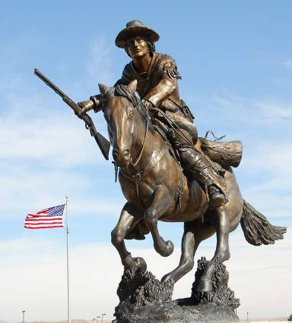
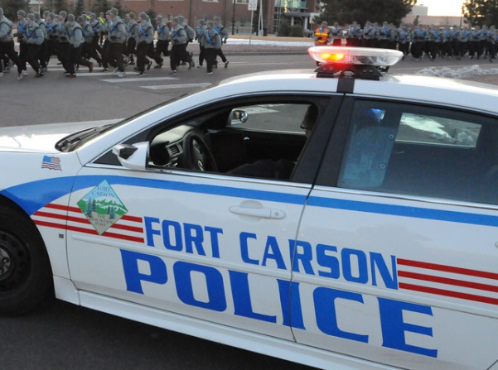
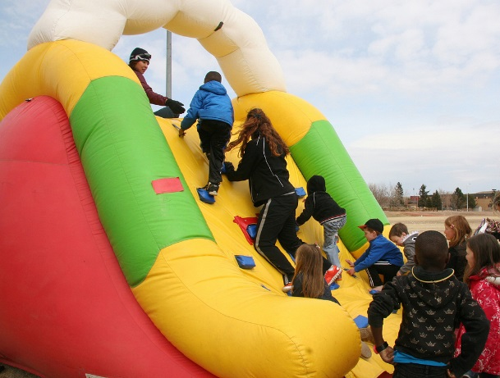
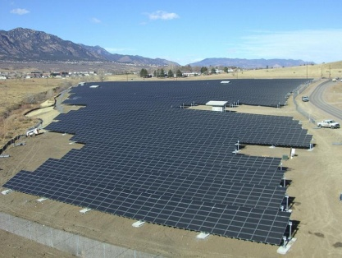
Joint Task Force Carson
Senior Mission Commander Priorities:
Support to Current Fight
Good Stewards of Government Funds
Transition Services for Separating Soldiers and Family Members
Fort Carson Quick Facts
Over 26,000 Active Duty Military
Over 42,00 Family Members
6,300 Army Civilians
Over 47,000 Local Retirees
5 Schools on Fort Carson (3,800 children capacity)
Over 2.2 Billion Dollar Impact to Local Area
Fort Carson has 137,000 acres
236,000 acres in Pinon Canyon Maneuver Site
Notes:
FCCO SC operational priorities
Support to current fight
Concurrent processing of mission critical exemptions to the civilian hiring freeze between IMCOM & CHRA to minimize the loss of effective operations while the gap between FY14 authorizations and on-board strength continues to grow
Restore capability to perform routine service order maintenance to avoid failure of infrastructure systems and more costly repair/restoration
Enhance existing Transition Services for separating Soldiers and family Members
Energy Efficiency is the 1st Priority
14.4% energy intensity reduction from FY03 baseline
Using ECIP and SRM funds for lighting upgrades, boiler replacements, Utility Control System expansion, etc.
Design of new facilities focused on energy efficiency
Initiated Energy Savings Performance Contract (ESPC) with Johnson Controls
Renewable Energy is the 2nd Priority
3% of Fort Carson’s electric use is generated from on-site renewable energy systems
Largest photovoltaic (PV) array in the Army (2 MW) completed through Power Purchase Agreement in 2007
Completing Net Zero Environmental Assessment through AEC for over a dozen potential renewable energy sites
Partnership with NREL to complete Net Zero Assessment
Host site for large microgrid demonstration
Challenges
Low utility rates have a negative impact on life cycle analysis
Community/utility renewable energy goals are not as aggressive as Federal/DOD goals
Fort Carson Community
Over 26,000 Active Duty Military
Over 42,00 Family Members
6,300 Army Civilians
Over 47,000 local retirees
14th Largest City in Colorado
Acreage
Fort Carson: approximately 137,000 acres
Pinon Canyon Maneuver Site: approximately 236,000 acres
Community Services
Fire & Emergency Services – 5 stations
Evans Army Community Hospital
Dental Services
Commissary and Post Exchange
4 Elementary Schools (capacity = 2500)
1 Middle School (capacity = 1,300)
6 Child Development Centers
Fort Carson Finances
Military Payroll $ 1.5B
Civilian Payroll $ 225M
Local purchases $ 20.0M
Contract Awards $ 160M
Utilities $ 21.5M
Military Construction $ 105M
Tuition Assistance/Grants $ 7M
TRICARE Payments $ 142M
Total $ 2.2B
Colorado Springs
Public Sector 23%
Military Workforce 10.5%
Economic Impact 35% +

